Slide 1

AASD 4004
Machine Learning - II
Applied AI Solutions Developer Program

Slide 2
Module 15
Feature Extraction in Audio
Vejey Gandyer

Slide 3
Agenda
Feature Extraction
Short-term feature extraction
Mid-term feature extraction
Spectral Centroids
Spectral Rolloff
Spectrogram
MFCC

Slide 4
Feature Extraction
What is it?

Slide 5
Feature Extraction
Extracting a set of features that are informative with respect to the desired properties of the original data
Low-level features to construct a higher-level of understanding
Need to extract audio features capable of discriminating between different audio classes i.e. speakers, emotions, genres

Slide 6
Short-term windowing (framing)
Split audio signal into short-term overlapping or non-overlapping windows (frames)
Length of the frames 10ms to 100ms
For each frame, extract a set of short-term Time-domain features (directly from audio sample values) or Frequency-domain features (from FFT values of the signal)
Ex: If energy and spectral centroid are extracted, sequence of 2D short-term feature vectors are outputted
If the audio files have different duration, what will happen?

Slide 7
Representing arbitrary-sized audio segments
Zero pad the feature sequences to the maximum duration of the dataset, concatenate the different short-term feature sequences to a single feature vector
Issues
High dimensionality, so need for more data samples while training
Dependent on temporal positions of feature values

Slide 8
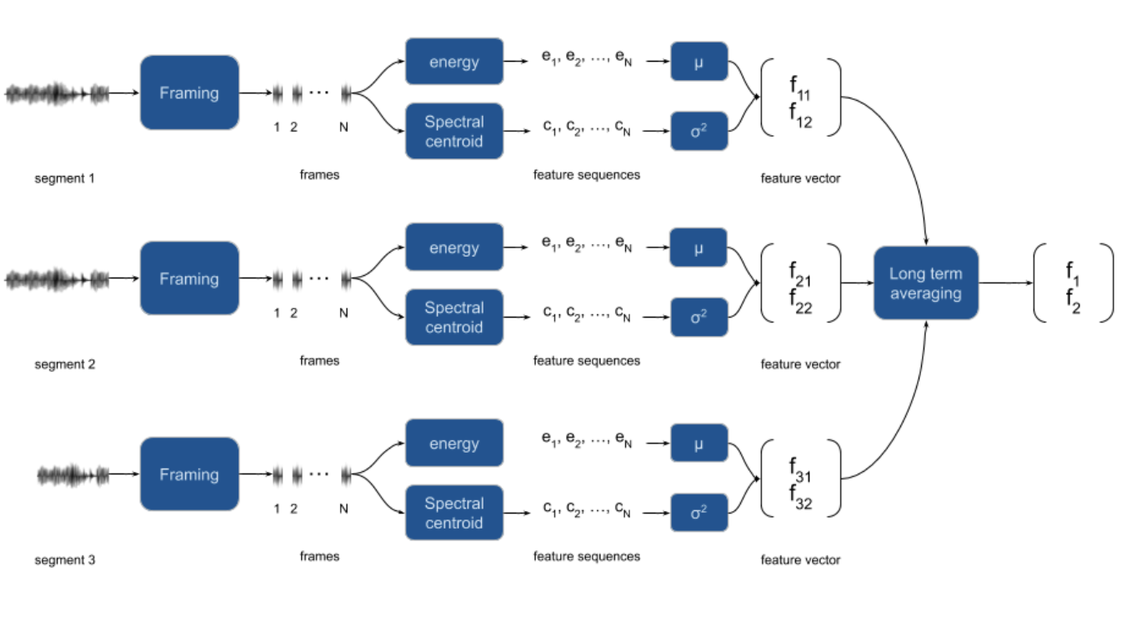
Representing arbitrary-sized audio segments
Solution: Extract a set of feature statistics (usually Mean and SD) per fix-sized segment
Segment-level statistics extracted over the short-term feature sequences are the representations for each fix-sized segment

Slide 9
Short-term Feature Extraction

Slide 10
Short-term Feature Extraction
Splits the input signal into short-term windows (frames) and computes several features for each frame
Total number of short-term features is 34

Slide 11
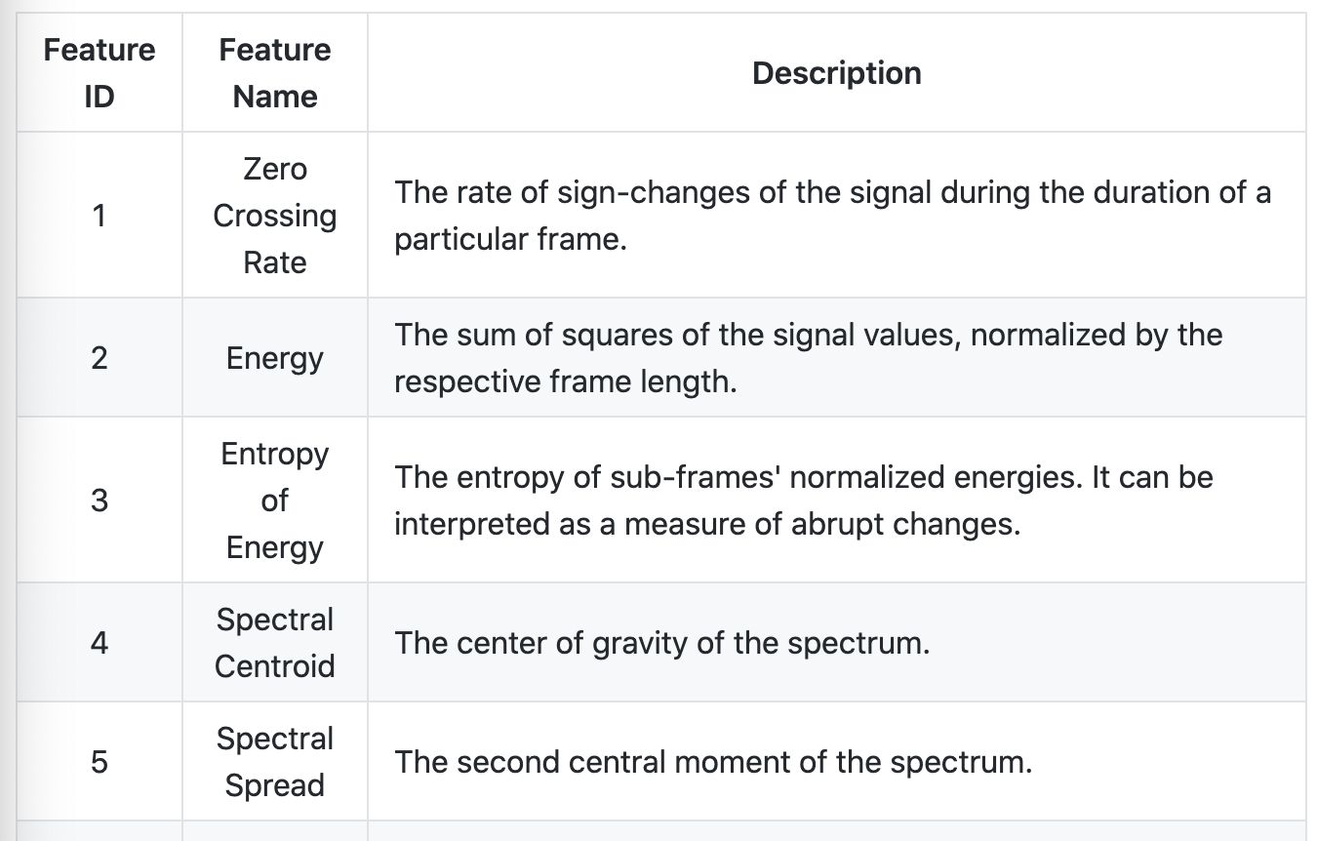
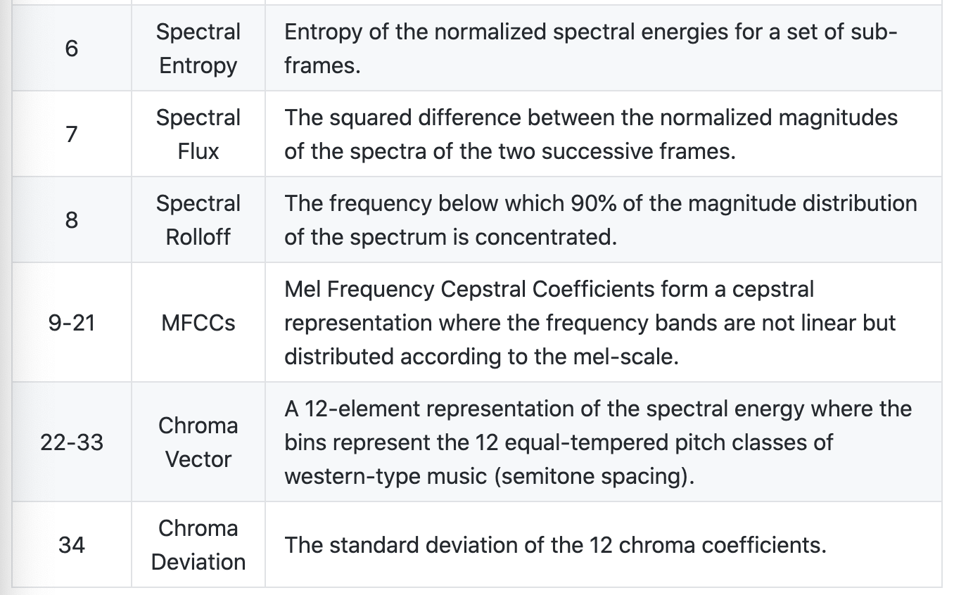
Short-term Feature Extraction

Slide 12
Audio Analysis Tasks
Extract audio features and representations (e.g. mfccs, spectrogram, chromagram)
Train, parameter tune and evaluate classifiers of audio segments
Classify unknown sounds
Detect audio events and exclude silence periods from long recordings
Perform supervised segmentation (joint segmentation - classification)
Perform unsupervised segmentation (e.g. speaker diarization) & extract audio thumbnails
Train and use audio regression models (example application: emotion recognition)
Apply dimensionality reduction to visualize audio data and content similarities

Slide 13
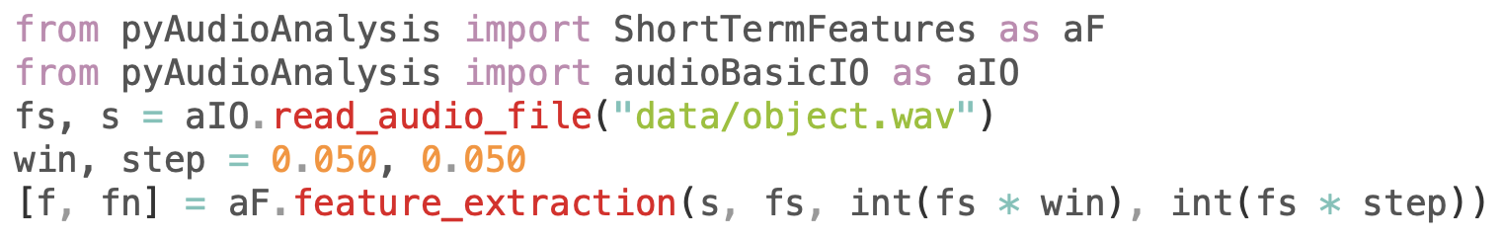
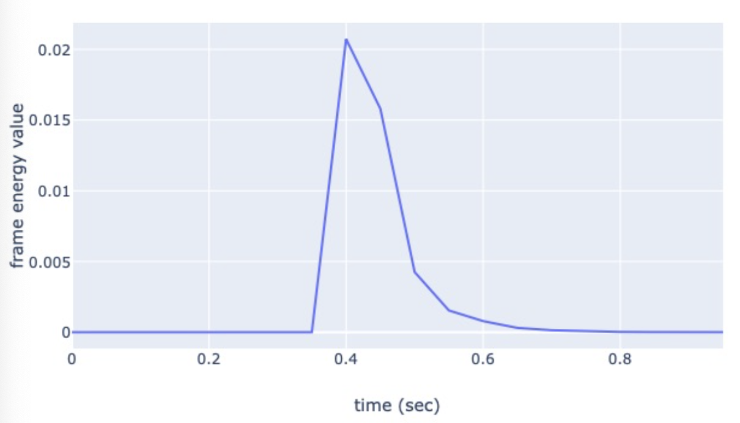
Short-term feature sequences
read_audio_file()
Sampling rate F_{s} & Array of raw values s
Feature_extraction()
68 x 20 Short-term feature matrix
68-length list of strings

Slide 14
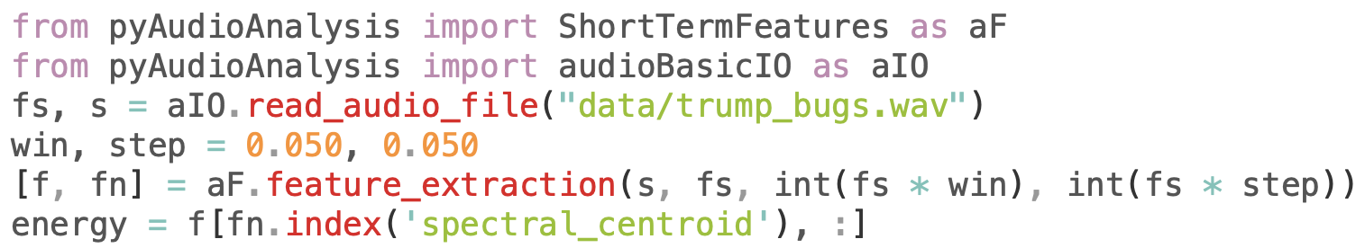
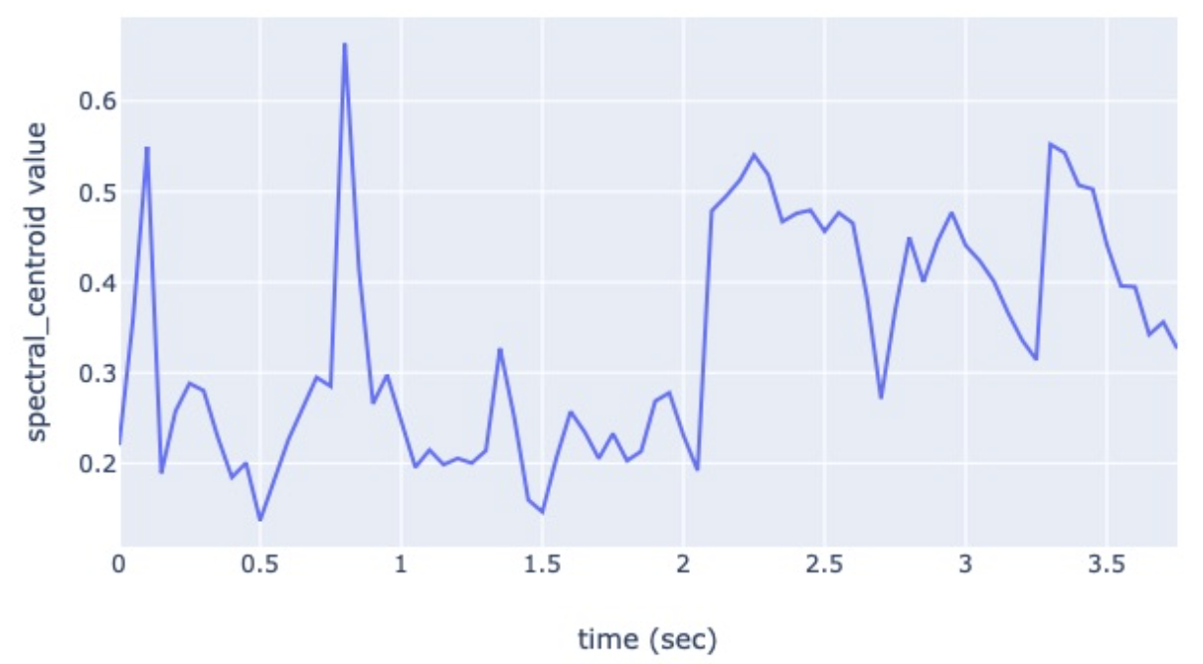
Spectral Centroid Short-term feature
Spectral centroid
Centroid of the FFT magnitude normalized in the frequency range [0, Fs / 2]
Spectral centroid = 0.5 = Fs / 4 in Hz

Slide 15
Mid-term Feature Extraction

Slide 16
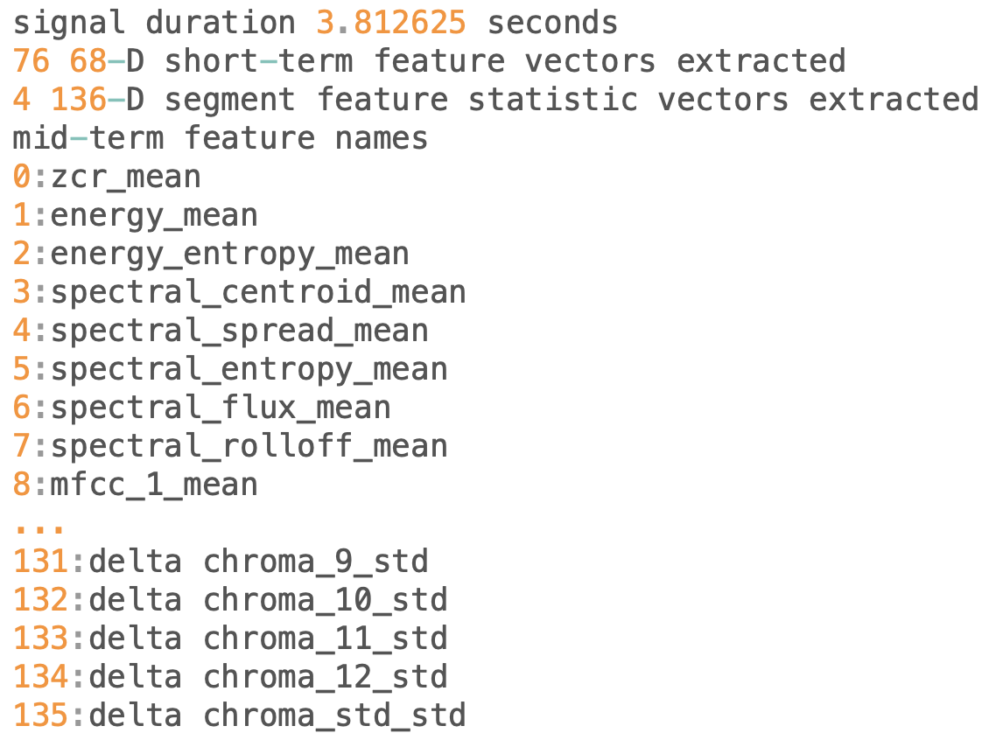
Segment-level Statistics Mid-term feature
mid_feature_extraction() Mean and SD
Example:
Duration of audio clip = 3.8 seconds
Mid-term window step & size = 1 second
No. Of Mid-term segments = 4
No. Of Short-term frames = 3.8 / 0.05 = 76

Slide 17
Segment-level Statistics Mid-term feature
Example: Analyze a song of 120 seconds with a short-term window (and step) of 50 ms and a mid-term (segment) window and step of 1 second. What are the steps?
Duration of audio clip = 120 seconds
No. Of Short-term frames = 120 / 0.05 = 2400; Short-term feature vectors = 2400 x 68
Mid-term window step & size = 1 second; No. Of Mid-term segments = 120 / 1 = 120
Segment-level feature statistics = 120 x 136 (Mean & SD of 68-D vector sequences)
120 x 136 matrix is long-term averaged for the whole song
2 beat-related features are appended as well; Total 120 x 138 values

Slide 18
Spectrogram

Slide 19
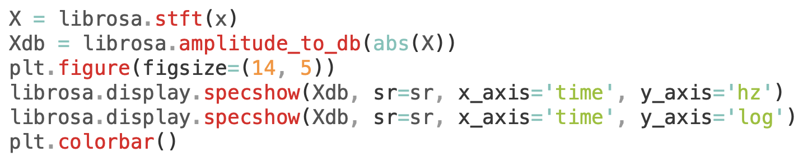
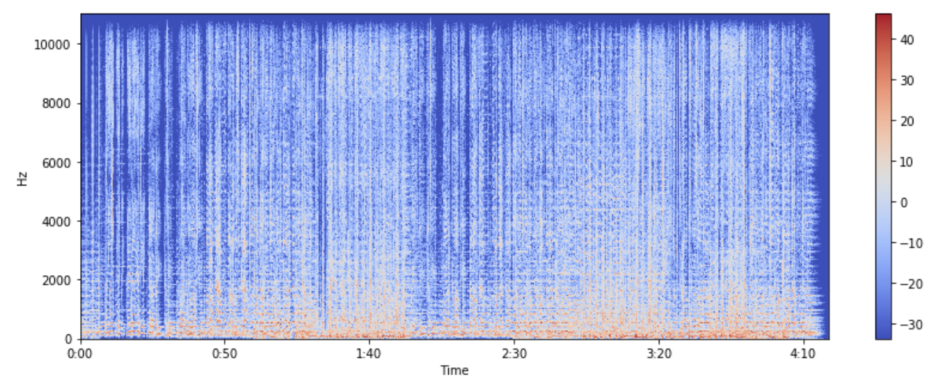
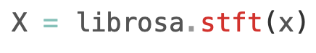
Spectrogram
Visual Representation of frequencies changing with respect to time for given music signals

Slide 20
Zero Crossings

Slide 21
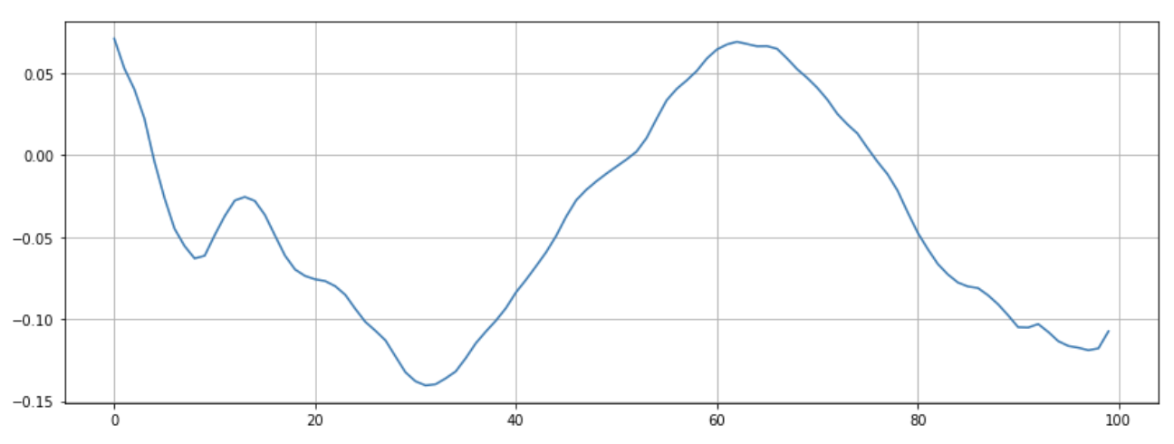
Zero Crossings
Rate of sign-changes along a signal

Slide 22
Spectral Centroid

Slide 23
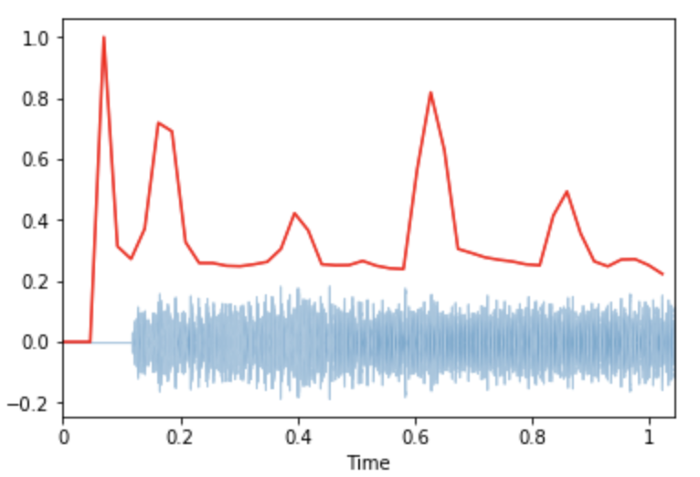
Spectral Centroid
Centre of mass for a sound signal - weighted mean of the frequencies

Slide 24
Spectral Rolloff

Slide 25
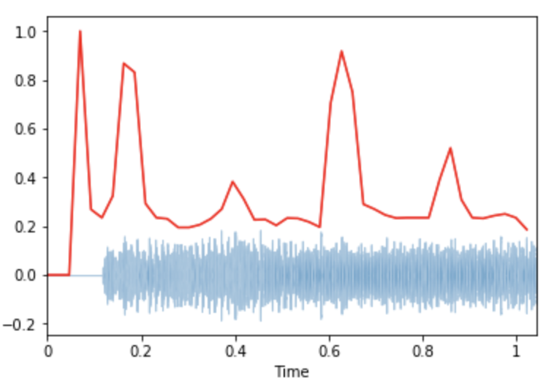
Spectral Rolloff
Frequency below which a specified percentage of the total spectral energy lies

Slide 26
Chromogram

Slide 27
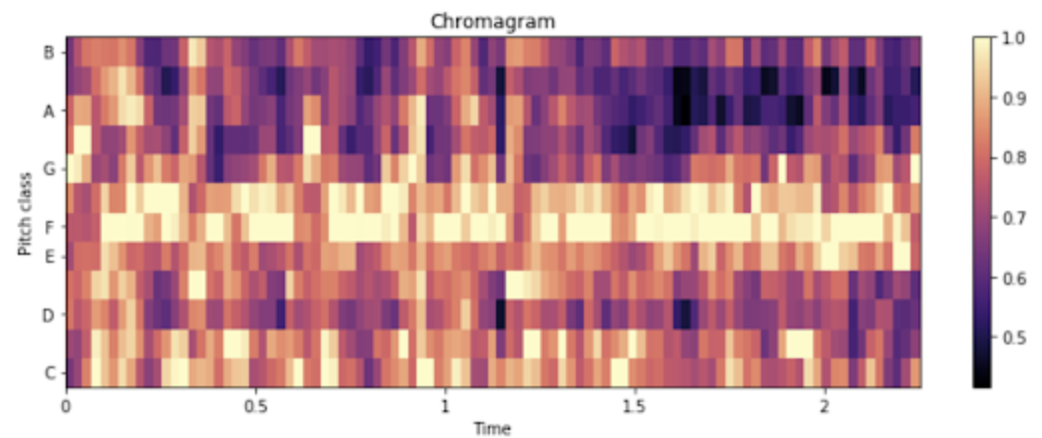
Chromagram
Relates to twelve different pitch classes
Powerful tool for analyzing music with respect to pitches

Slide 28
MFCC

Slide 29
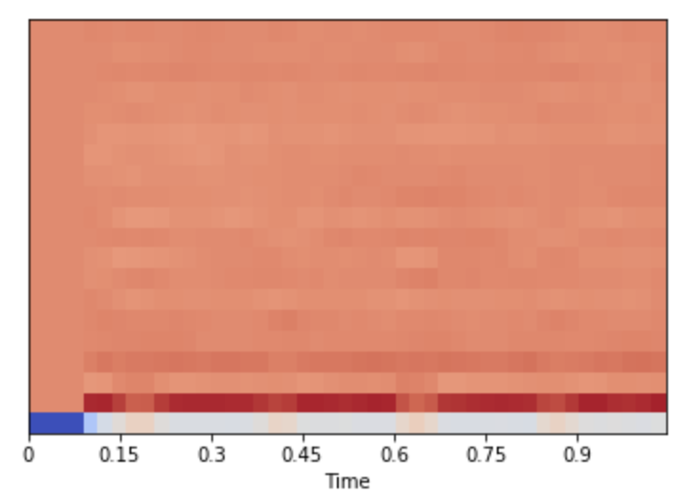
Mel-Frequency Cepstral Coefficients
Small set of features (usually about 10-20)
Describes shape of a spectral envelope

Slide 30
Further Reading
PyAudioAnalysis
https://github.com/tyiannak/pyAudioAnalysis
Feature Extraction
https://github.com/tyiannak/pyAudioAnalysis/wiki/3.-Feature-Extraction
https://github.com/tyiannak/basic_audio_analysis/blob/master/notebobok.ipynb
https://hackernoon.com/intro-to-audio-analysis-recognizing-sounds-using-machine-learning-qy2r3ufl

